Slide 1

UACT and CVUSD
Certificated Employee Development
and Evaluation Procedures
For The 2015-16 School Year

Slide 2
INTRODUCTION
The purpose of an effective teacher /nurse development and evaluation system is to inform, instruct and improve teaching and learning; to provide educators with prompt/timely and meaningful feedback on areas of strength and where improvement is needed; and to ensure fair and evidence-based employment decisions.
Timely professional development opportunities should be embedded throughout a member’s evaluation system to support their growth and advancement.

Slide 3
THE IMPORTANCE OF CONVERSATIONS
What I have realized is what really affects behavior and performance is the conversation between administrator(s) and bargaining unit member(s) on an ongoing basis throughout the school year.
If administration is using the evaluation process as a ”gotcha” the evaluation process will never work in favor of site administration, teacher, nor students.

Slide 4
California Standards for the Teaching Profession (CSTPs)
Engaging and Supporting All Students in Learning
Creating and Maintaining Effective Environment for Student Learning
Understanding and Organizing Subject Matter for Student Learning
Planning Instruction and Designing Learning Experiences for All Students
Assessing Student Learning
Developing as a Professional Educator

Slide 5
California Standards for the Teaching Profession (CSTPs)
Importance of CSTPs:
  Prompt reflection about student learning and teaching practice;
  Formulate professional goals to improve teaching practice; and
  Guide, monitor, and assess the progress of a teacher’s practice toward professional goals and professionally-accepted standards.

Slide 6
Probationary Bargaining Unit Members
Probationary bargaining unit members are to be observed no less than two times per year and have at least one evaluation.
Year: | 1 | 2
At Least Two Observations – At Least One Evaluation

Slide 7
Permanent Bargaining Unit Member
Permanent bargaining unit members are to be observed no less than one time per year and have at least one evaluation based on the following schedule:
Years: | 3 | 4 | 6 | 8 | 10 | 15 | 20 | 25 | 30
At Least One Observation – At Least One Evaluation
Observations and Evaluations outside a permanent bargaining unit member’s evaluation cycle is at the discretion of the site administration.

Slide 8
Temporary Bargaining Unit Members
Temporary bargaining unit members are to be observed no less than two times per year and have at least one evaluation.
Year: | Every Year
At Least Two Observations – At Least One Evaluation

Slide 9
Notification Of Evaluation Year
The Principal (or Immediate Supervisor in the case of the District Office) is responsible for informing the staff of the evaluation procedures during the first two weeks (first three weeks) of their evaluation year. Notification should be given through email.
Check the email box that it was received and the receipt that it was opened.
2015-16 MOU to push back dates

Slide 10
Standards and Key Elements
Between the third week of school and the seventh week (ninth week) of school, the administrator and bargaining unit members will meet for their Standards and Key Elements meeting to select the required number of Standards from the CSTPs that will be evaluated in the course of the evaluation process.

Slide 11
Standards and Key Elements
For a bargaining unit member in probationary or temporary status, all standards and key elements will be selected for the focus of the evaluation.
The administrator and the bargaining unit members in permanent status shall select three (3) standards upon which the evaluation will be based.
  i. One standard selected by the bargaining unit member
  ii. One standard selected by the administrator
  iii. One standard selected jointly by the bargaining unit member and the administrator
  iv. Standard six – imbedded into Board Policy

Slide 12
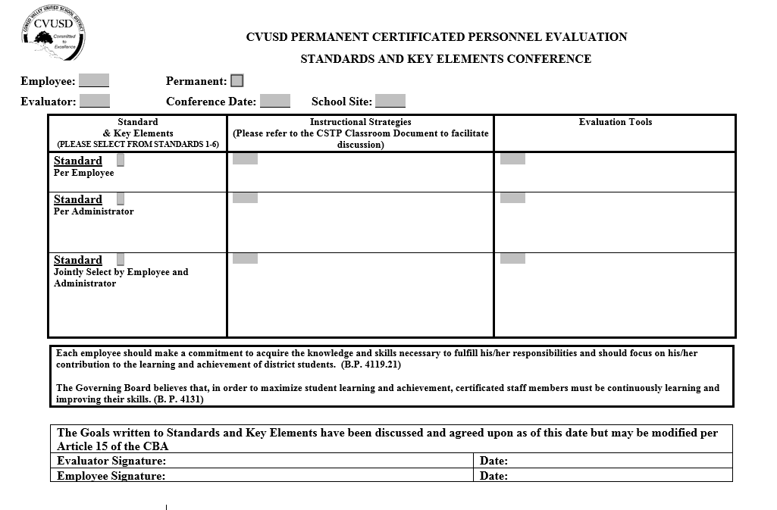
CERTIFICATED PERSONNEL EVALUATION STANDARDS AND KEY ELEMENTS CONFERENCE
Employee: Permanent: Probationary:
Evaluator: Conference Date: School Site:
Standard & Key Elements | Instructional Strategies | Evaluation Tools
Standard Key Element
Standard Key Element
Standard Key Element
Standard Key Element
Standard Key Element
Standard Key Element
Standard Key Element
Standard Key Element
Standard Key Element
The Goals written to Standards and Key Elements have been discussed and agreed upon as of this date but may be modified per Article 9 of the Contract
Evaluator Signature: | Date:
Employee Signature: | Date:

Slide 13
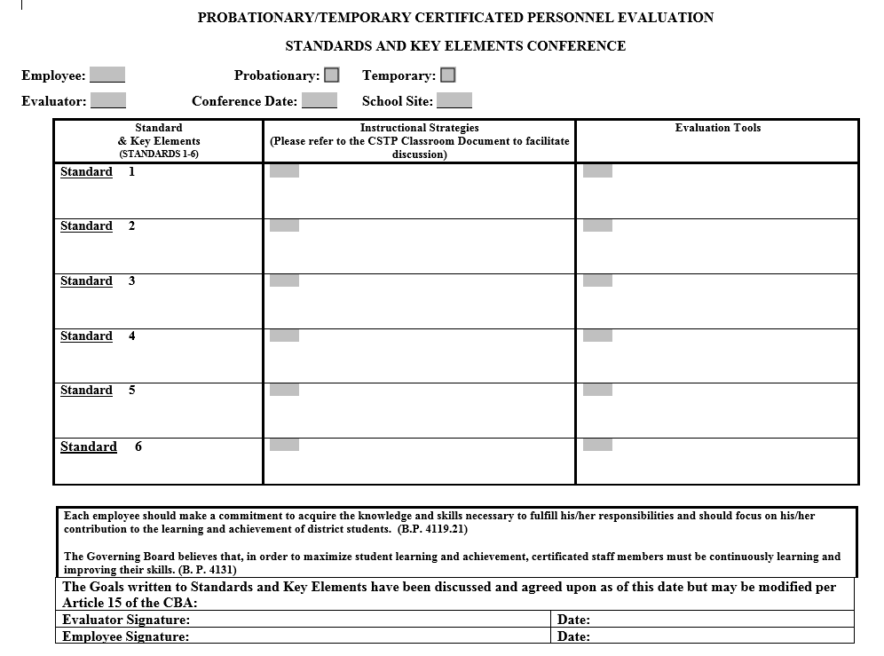
CERTIFICATED PERSONNEL EVALUATION STANDARDS AND KEY ELEMENTS CONFERENCE
Employee: Permanent: Probationary:
Evaluator: Conference Date: School Site:
Standard & Key Elements | Instructional Strategies | Evaluation Tools
Standard Key Element
Standard Key Element
Standard Key Element
Standard Key Element
Standard Key Element
Standard Key Element
Standard Key Element
Standard Key Element
Standard Key Element
The Goals written to Standards and Key Elements have been discussed and agreed upon as of this date but may be modified per Article 9 of the Contract
Evaluator Signature: | Date:
Employee Signature: | Date:

Slide 14
Observation Process
The Classroom Observation Form will be used for the purpose of recording classroom observations.
A minimum of one formal classroom observation is required for permanent bargaining unit members.
A minimum of two formal classroom observations are required for non-permanent bargaining unit members.
No limit on informal observations

Slide 15
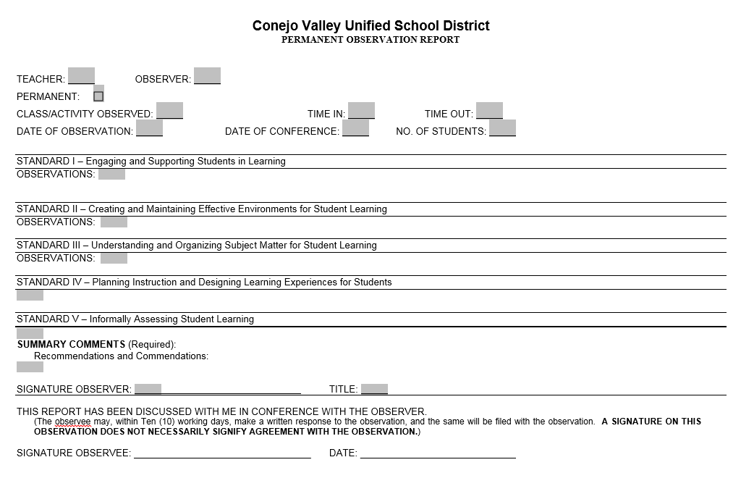
APPENDIX D
OBSERVATION FORM
DETAILED INFORMATION IN RELATION TO OBSERVATION FORM.
ACTIVITY (Method and Techniques)
The lesson, lecture, demonstration, discussion, panel, student reports.
EQUIPMENT USED (If Any)
A.V., other aids (commercial or homemade), sufficient quantity.
RESPONSE OF STUDENTS
Attentiveness, interaction (verbal), appearance of understanding lesson, demonstration of skill, students exhibit what instructor expects of them.
ORGANIZATION
Opening and ending procedures, grouping, necessary material readily available, optimum use of time, lesson plans, organized and in sufficient detail to enable teacher to maintain continuity.
APPEARANCE OF ROOM OR AREA (Within Control of Teacher)
Neatness, organized, light, heat, bulletin boards, pleasant atmosphere, is room shared.
FACTORS AFFECTING CLASS
Number of students, composition of class, interruptions, weather, activity that day or previous and subsequent to, Special Education students.

Slide 16
Bargaining Unit Member Evaluation
The evaluation shall focus on progress towards meeting the selected standards.
In preparing the final evaluation document, the administrator shall rely exclusively upon the following:
  Data collected through actual formal and informal classroom observations/walk-throughs of the bargaining unit member’s performance.
  The discussions in observation and evaluation conference(s).

Slide 17
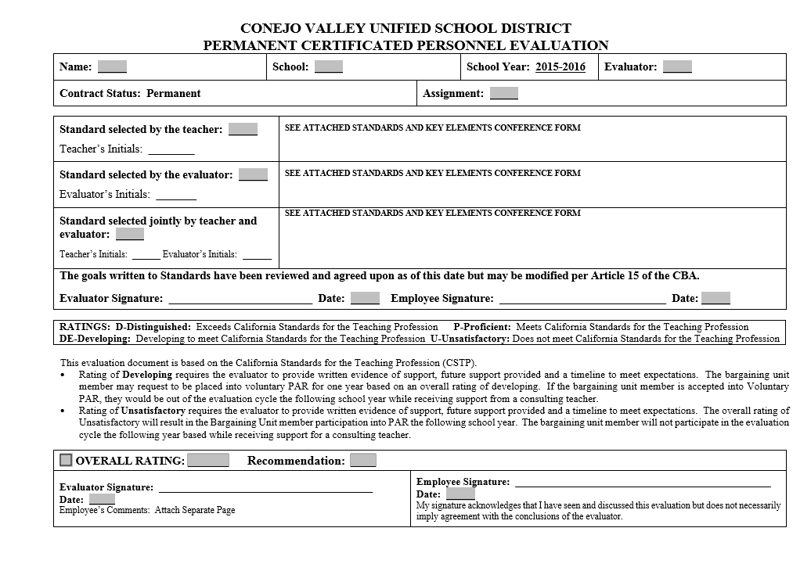

Slide 18
Bargaining Unit Member Evaluation
RATINGS:
  D-Distinguished: Exceeds California Standards for the Teaching Profession
  P-Proficient: Meets California Standards for the Teaching Profession
  DE-Developing: Developing to meet California Standards for the Teaching Profession
  U-Unsatisfactory: Does not meet California Standards for the Teaching Profession

Slide 19
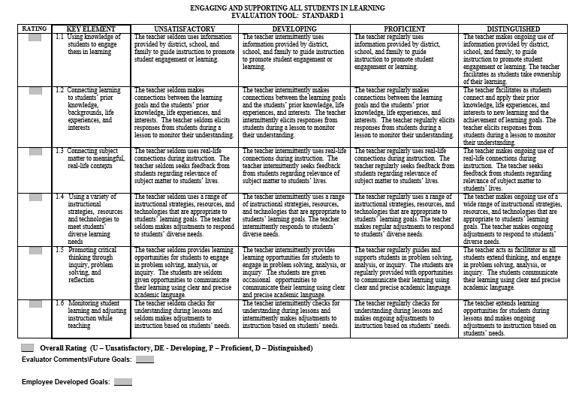

Slide 20
Bargaining Unit Member Evaluation
If the bargaining unit member receives an overall rating of “developing” in the written evaluation document, a Site-Level Development Plan document must be completed during the evaluation conference or a follow-up evaluation conference.
Define how this happens - majority of boxes checked as “developing” or “unsatisfactory”.

Slide 21
Bargaining Unit Member Evaluation
At the time of the evaluation conference for a bargaining unit member who receives an overall “unsatisfactory” final evaluation, she/he must be informed in writing by the administrator that the bargaining unit member must participate in the Required Peer Assistance and Review (PAR) process the following school year.
Define

Slide 22
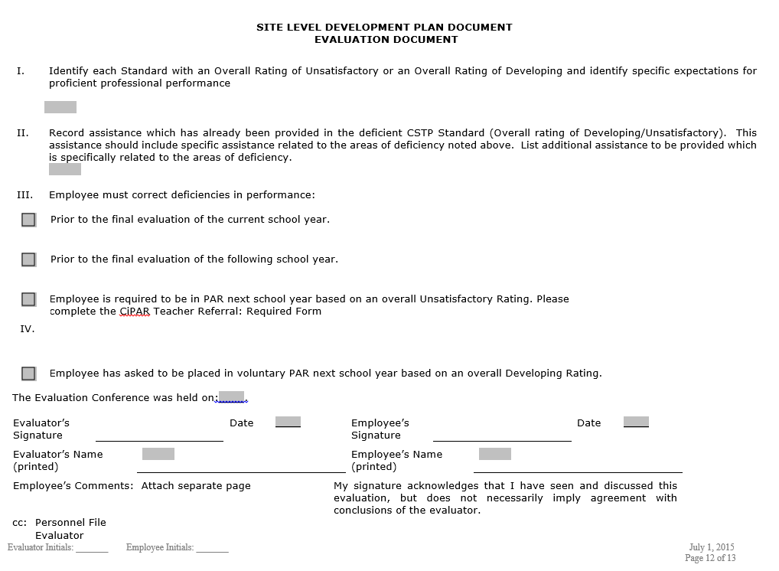

Slide 23
PAR Referral
CBA Article 34: The goal of a peer assistance program (voluntary) or a peer assistance and review (required) program is to help teachers develop practices to improve instruction and student performance.

Slide 24
CBA - EVALUATIONS
Review Collective Bargaining Agreement Language for Article 15: Employee Development and Evaluation Procedures

Slide 25
Process Timelines / MOU
Timeline | Event
Week: 1 – 2 / 1 – 3 | Notification to Teacher
Week: 3 – 7 / 4 - 9 | Standards and Key Elements Meeting
By March 1st | All unit members should have received at least one written report of a formal observation
Week: 30 | Final Evaluation Meeting Must Be Held
Week: 32 | Evaluation due to Personnel Services
Please work with Personnel Office If There Are Any Possible Non-Reelects
Peer Assistance and Review (PAR)
Last Day Of April | A permanent teacher may request Voluntary PAR
Last Day of April | The School Principal shall refer a permanent teacher with an unsatisfactory evaluation to PAR
No Later than Last Day of May | The CiPAR Governance Committee will issue a decision about PAR Participation For the following school year

Slide 26
CERTIFICATED PERSONNEL EVALUATION STANDARDS AND KEY ELEMENTS CONFERENCE
Employee: Permanent: Probationary:
Evaluator: Conference Date: School Site:
Standard & Key Elements | Instructional Strategies | Evaluation Tools
Standard Key Element
Standard Key Element
Standard Key Element
Standard Key Element
Standard Key Element
Standard Key Element
Standard Key Element
Standard Key Element
Standard Key Element
The Goals written to Standards and Key Elements have been discussed and agreed upon as of this date but may be modified per Article 9 of the Contract
Evaluator Signature: | Date:
Employee Signature: | Date:

Slide 27
CERTIFICATED PERSONNEL EVALUATION STANDARDS AND KEY ELEMENTS CONFERENCE
Employee: Permanent: Probationary:
Evaluator: Conference Date: School Site:
Standard & Key Elements | Instructional Strategies | Evaluation Tools
Standard Key Element
Standard Key Element
Standard Key Element
Standard Key Element
Standard Key Element
Standard Key Element
Standard Key Element
Standard Key Element
Standard Key Element
The Goals written to Standards and Key Elements have been discussed and agreed upon as of this date but may be modified per Article 9 of the Contract
Evaluator Signature: | Date:
Employee Signature: | Date:

Slide 28


Slide 30
APPENDIX D
OBSERVATION FORM
DETAILED INFORMATION IN RELATION TO OBSERVATION FORM.
ACTIVITY (Method and Techniques)
The lesson, lecture, demonstration, discussion, panel, student reports.
EQUIPMENT USED (If Any)
A.V., other aids (commercial or homemade), sufficient quantity.
RESPONSE OF STUDENTS
Attentiveness, interaction (verbal), appearance of understanding lesson, demonstration of skill, students exhibit what instructor expects of them.
ORGANIZATION
Opening and ending procedures, grouping, necessary material readily available, optimum use of time, lesson plans, organized and in sufficient detail to enable teacher to maintain continuity.
APPEARANCE OF ROOM OR AREA (Within Control of Teacher)
Neatness, organized, light, heat, bulletin boards, pleasant atmosphere, is room shared.
FACTORS AFFECTING CLASS
Number of students, composition of class, interruptions, weather, activity that day or previous and subsequent to, Special Education students.

Slide 32
Parting Tips
Be professional and calm- if you’re not, that’s the only thing the teacher will remember.
Drop a note after the observation. Something short and positive.
Meet with the member ASAP after the evaluation. The anxiety is tough to handle.
Ask questions before making statements about what happened. The Socratic Method may get you more reflection than you think.

Slide 33
Questions

